Slide 1
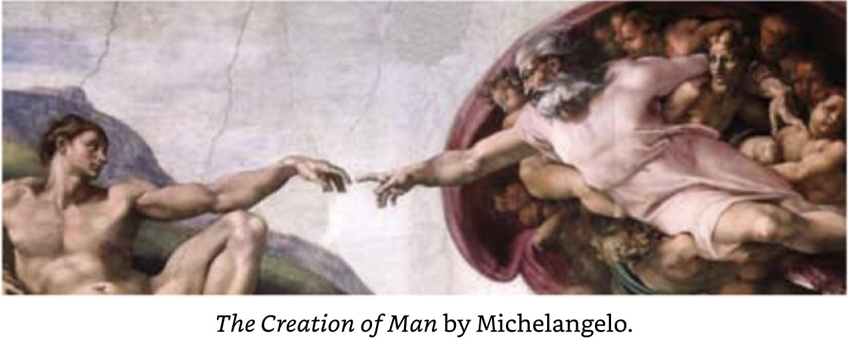
CREATION (GENESIS 1:1 – 2:3)
Lesson #15

Slide 2
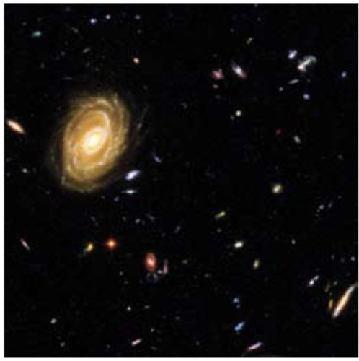
“¹ In the beginning God created (BARA) the heavens and the earth.”
(Genesis 1:1)
The Universe had a beginning.
The universe was created from nothing.
The universe was created according to God’s will.

Slide 3
Creation “Ex Nihilo” is a Latin phrase meaning “Out of nothing.” It can only be the work of a transcendent God, one who is outside of His Creation. He must have unlimited power to bring all things into being.
God brought all matter, space, energy and time into being from absolutely nothing.

Slide 4
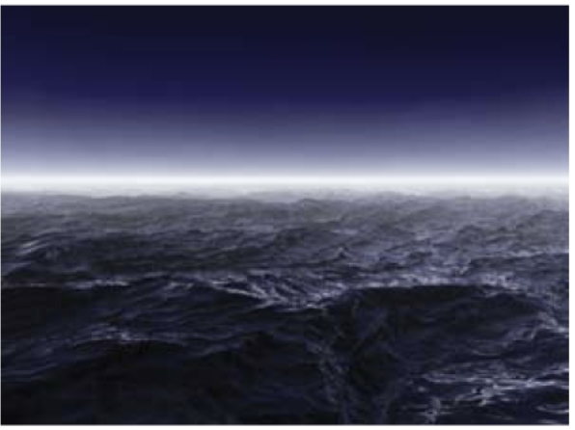
^{“2} Now the earth was formless and empty, darkness was over the surface of the deep, and the Spirit of God was hovering over the waters.”
  Earth was “formless” and “empty.” These are Hebrew rhyming words “Tohu” and “Bohu.” Earth was uninhabitable, covered in water and darkness.
  Had God already created light? Perhaps, if verse 1 preceded the creation days, He “had created the heavens” with its many galaxies (including starlight.) But light had not yet reached Earth’s surface.
  Spirit of God hovering over the waters.

Slide 5
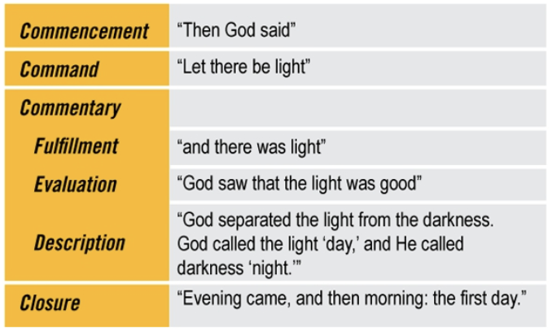
Starting in verse 3 we see a literary devise, a pattern: Each day is introduced with “Then God Said... And closes with “Evening came, then morning...”
Notice: Verses 1 & 2 don’t follow this pattern. The creation of heavens and earth in vs 1 & 2 may have happened separately from Creation Day 1.

Slide 6
More Literary Devices: DIFFERENT CREATION VERBS
BARA = To create, fashion or form, Only God vs. 1, 21, 27 2:3
HAYA = To exist, come to pass, happen vs. 3, 6, 14
ASAH = To do, make. Applies to man or God –
reworking existing material vs. 7, 11-12, 16, 25, 26, 31, 2:3
RAAH = To appear, be visible vs. 9
YATSA = To bring forth, come out vs. 11
NATHAN = To set, appoint, assign vs. 17, 29

Slide 7
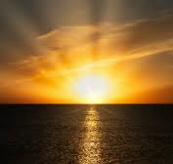
DAY 1
^{“3} And God said, “Let there be light, (HAYA)” and there was light. ⁴ God saw that the light was good, and he separated the light from the darkness. ⁵ God called the light “day,” and the darkness he called “night.” And there was evening, and there was morning—the first day.”
HAYA: Perhaps the meaning is “Let it come to pass” that light appears on the earth.” (Light may have been CREATED in vs.1 as part of the heavens’ galaxies.)

Slide 8
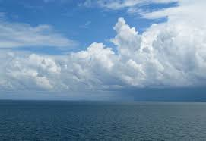
DAY 2
^{“6} And God said, ’Let there be (HAYA) a vault [expanse] between the waters to separate water from water.’ ⁷ So God made (ASAH) the [expanse] and separated the water under the [expanse] from the water above it. And it was so. ⁸ God called the [expanse] ‘sky.’ And there was evening, and there was morning—the second day.”

Slide 9
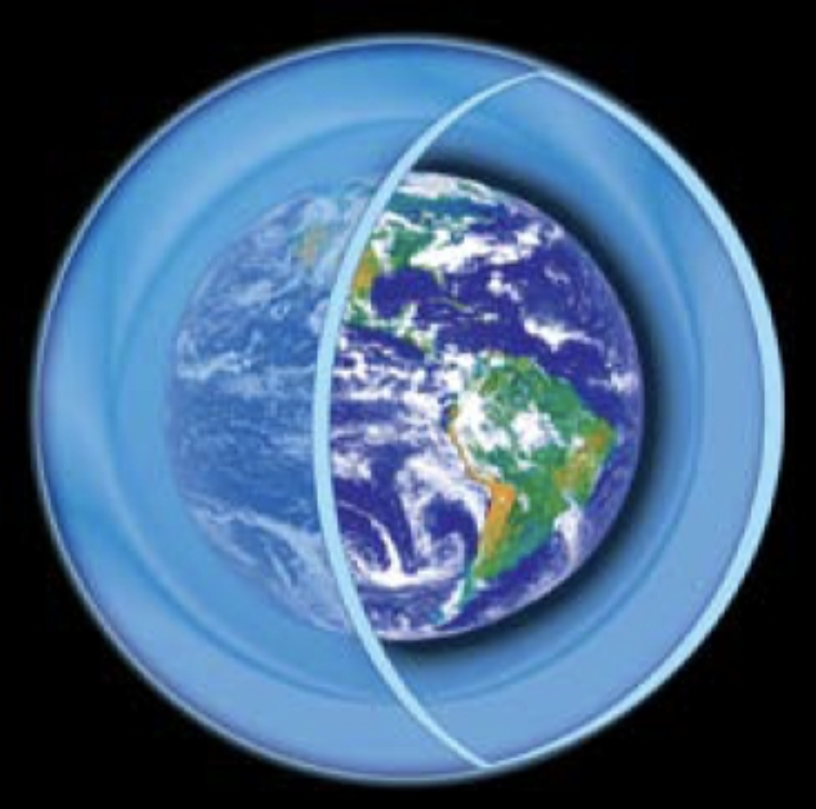
What is the “expanse” or “firmament?”
A water vapor canopy?
    Some have suggested that this would maintain a tropical environment, enable longevity of the early patriarchs, and provide the water for Noah’s flood.
But God calls the expanse “sky” and later says the birds fly there.
    In Psalm 19 David says the “expanse” is still there – this was after the Flood.
This idea has mostly been rejected.

Slide 10
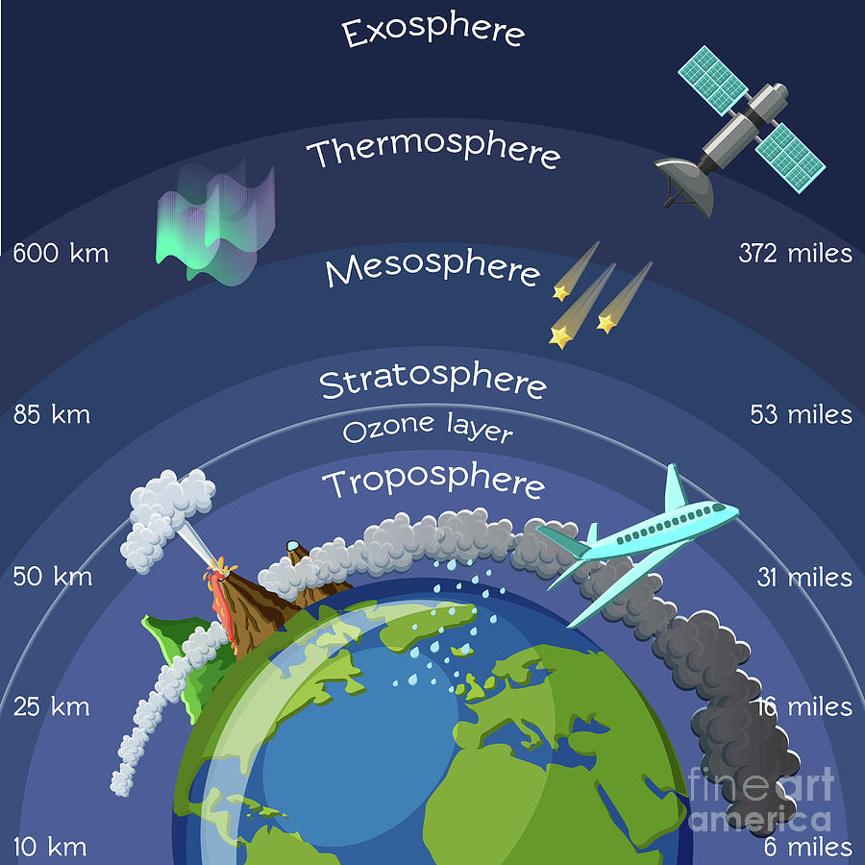
EXPANSE / FIRMAMENT
Perhaps the expanse is an example of using language to describe how it appears to the observer. It appears as a covering over the surface of the earth where birds fly, etc.
In modern language we speak of an atmosphere where layers have differing amounts of water.

Slide 11
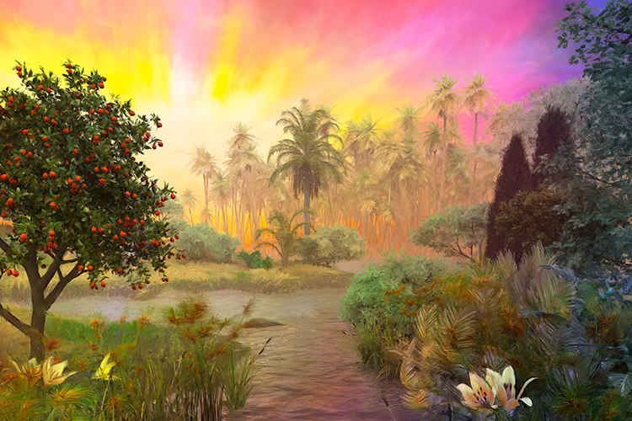
DAY 3
^{“9} And God said, “Let the water under the sky be gathered to one place, and let dry ground appear.” (RAAH) And it was so. ¹⁰ God called the dry ground “land,” and the gathered waters he called “seas.” And God saw that it was good.
¹¹ Then God said, “Let the land produce (DASHA) vegetation: seed-bearing plants and trees on the land that bear fruit with seed in it, according to their various kinds.” And it was so. ¹² The land produced (YATSA) vegetation: plants bearing seed according to their kinds and trees bearing fruit with seed in it according to their kinds. And God saw that it was good. ¹³ And there was evening, and there was morning—the third day.”

Slide 12
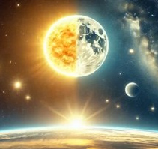
DAY 4
^{“14} And God said, “Let there be lights in the vault of the sky to separate the day from the night, and let them serve as signs to mark sacred times, and days and years,¹⁵ and let them be lights in the vault of the sky to give light on the earth.” And it was so. ¹⁶ God made (ASAH) two great lights—the greater light to govern the day and the lesser light to govern the night. He also made the stars. ¹⁷ God set them (NAHTAN) in the vault of the sky to give light on the earth, ¹⁸ to govern the day and the night, and to separate light from darkness. And God saw that it was good. ¹⁹ And there was evening, and there was morning—the fourth day.”
(Asah = To make, fashion, accomplish)

Slide 13
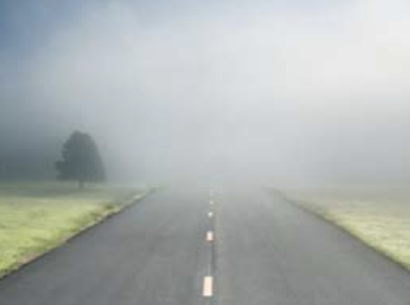
Light before SUN, MOON and STARS?
Possible Understandings:
Perhaps a temporary light source was at work on Day 1 and was replaced by the sun, moon and stars when they were created on Day 4.
Maybe the light came from God himself.
Perhaps the Sun was created as part of the heavens
in verse 1 and was the source of light on Day 1.
But it wasn’t until Day 4 that the sun, moon and stars
were visible from the surface of the earth. Then God
assigned them a new purpose.
When fog is thick, it is impossible to discern where the sun is located. Perhaps, the atmosphere was made clear enough to see the sun on on Day 4.

Slide 14
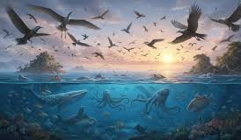
DAY 5
^{“20} And God said, “Let the water teem with living creatures, and let birds fly above the earth across the vault of the sky.” ²¹ So God created (BARA) the great creatures of the sea and every living thing with which the water teems and that moves about in it, according to their kinds, and every winged bird according to its kind. And God saw that it was good. ²² God blessed them and said, “Be fruitful and increase in number and fill the water in the seas and let the birds increase on the earth.”²³ And there was evening, and there was morning—the fifth day.”

Slide 15
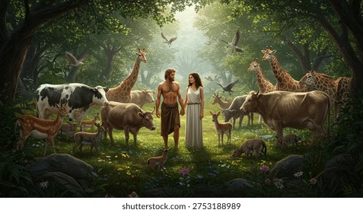
DAY 6
^{“24}And God said, “Let the land produce (YATSA) living creatures according to their kinds: the livestock, the creatures that move along the ground, and the wild animals, each according to its kind.” And it was so. ²⁵ God made (ASAH) the wild animals according to their kinds, the livestock according to their kinds, and all the creatures that move along the ground according to their kinds. And God saw that it was good.
²⁶ Then God said, “Let us make (ASAH) mankind in our image, in our likeness, so that they may rule over the fish in the sea and the birds in the sky, over the livestock and all the wild animals,^{[a]} and over all the creatures that move along the ground.” ²⁷ So, God created (BARA) mankind in his own image, in the image of God he created them; male and female he created them.”
“PG” picture... Of course they were naked. ☺

Slide 16
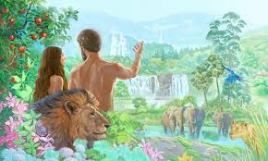
DAY 6 (cont.)
“²⁹ Then God said, “I give (NATHAN) you every seed-bearing plant on the face of the whole earth and every tree that has fruit with seed in it. They will be yours for food.
³⁰ And to all the beasts of the earth and all the birds in the sky and all the creatures that move along the ground—everything that has the breath of life in it—I give every green plant for food.” And it was so.
³¹ God saw all that he had made (ASAH), and it was very good. And there was evening, and there was morning—the sixth day.”

Slide 17
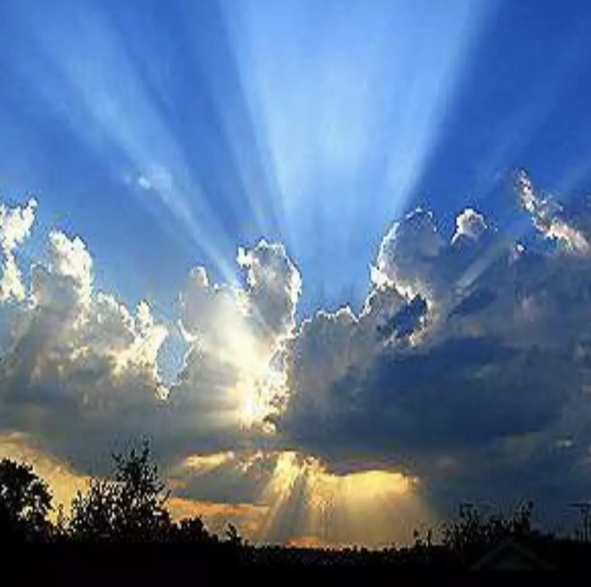
DAY 7
Genesis 2 ”¹Thus, the heavens and the earth were completed in all their vast array. ² By the seventh day God had finished the work he had been doing; so, on the seventh day He rested from all his work.
³ Then God blessed the seventh day and made it holy, because on it He rested from all the work of creating (BARA) that He had done.”

Slide 18
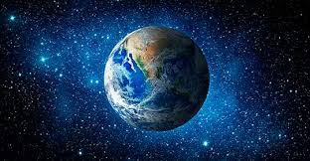
THE UNIVERSE HAD A BEGINNING.
THE UNIVERSE WAS CREATED FROM NOTHING.
THE UNIVERSE WAS CREATED ACCORDING TO GOD’S WILL.

Slide 19
PSALM 148:1–14 (NIV)
¹ Praise the LORD from the heavens; praise him in the heights above.
² Praise him, all his angels; praise him, all his heavenly hosts.
³ Praise him, sun and moon; praise him, all you shining stars.
⁴ Praise him, you highest heavens and you waters above the skies.
⁵ Let them praise the name of the LORD, for at his command they were created,
⁶ and he established them for ever and ever—he issued a decree that will never pass away.
⁷ Praise the LORD from the earth, you great sea creatures and all ocean depths,
⁸ lightning and hail, snow and clouds, stormy winds that do his bidding,
⁹ you mountains and all hills, fruit trees and all cedars,
¹⁰ wild animals and all cattle, small creatures and flying birds,
¹¹ kings of the earth and all nations, you princes and all rulers on earth,
¹² young men and women, old men and children.
¹³ Let them praise the name of the LORD, for his name alone is exalted; his splendor is above the earth and the heavens.
¹⁴ And he has raised up for his people a horn, the praise of all his faithful servants,
of Israel, the people close to his heart. Praise the LORD.

Slide 20
